Slide 1
Graphics Moodboard

Slide 2
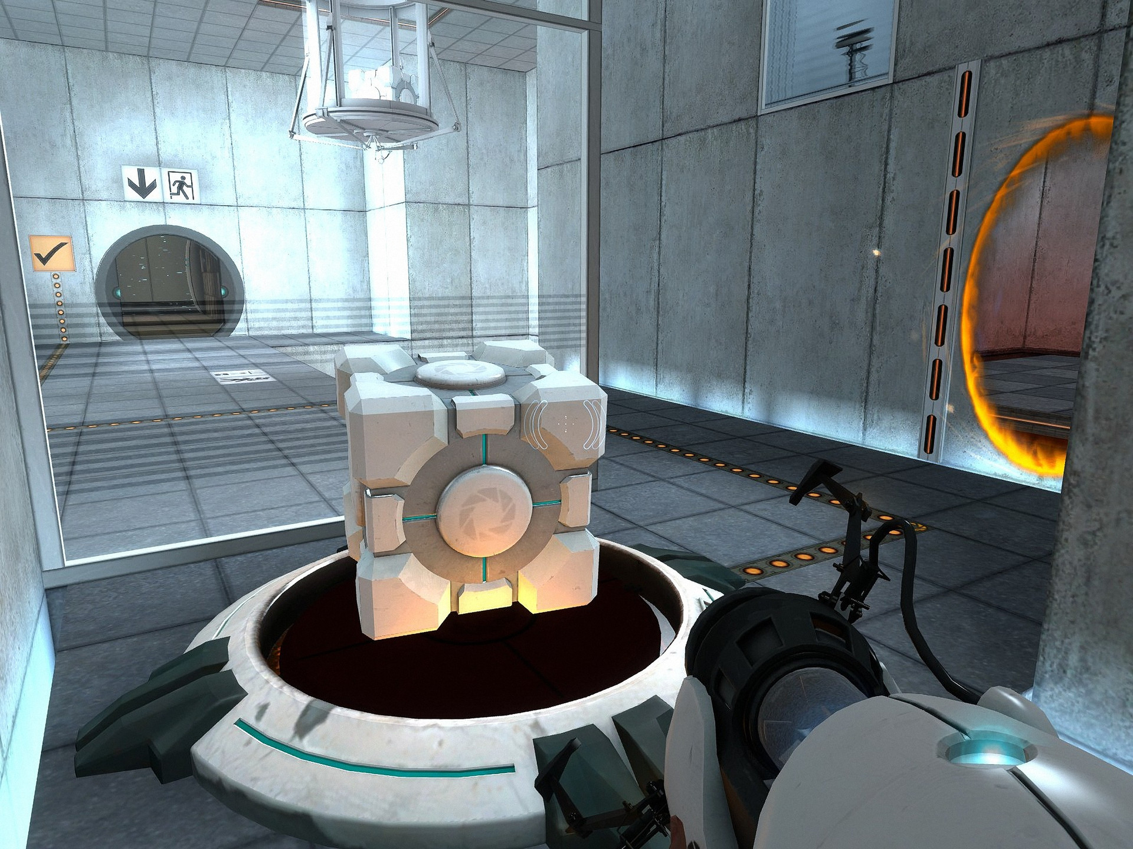
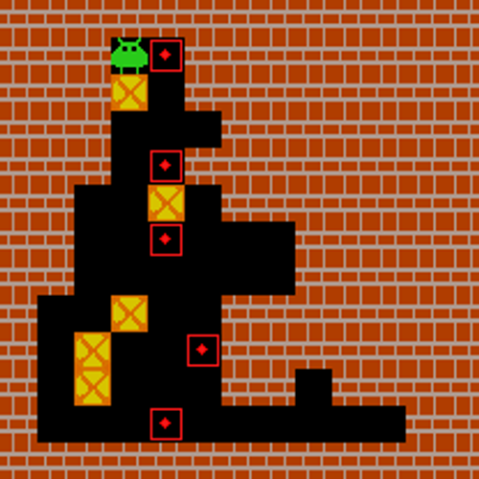
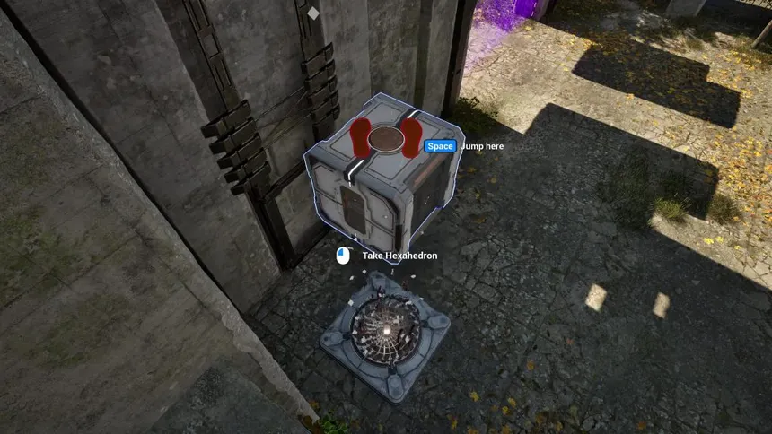
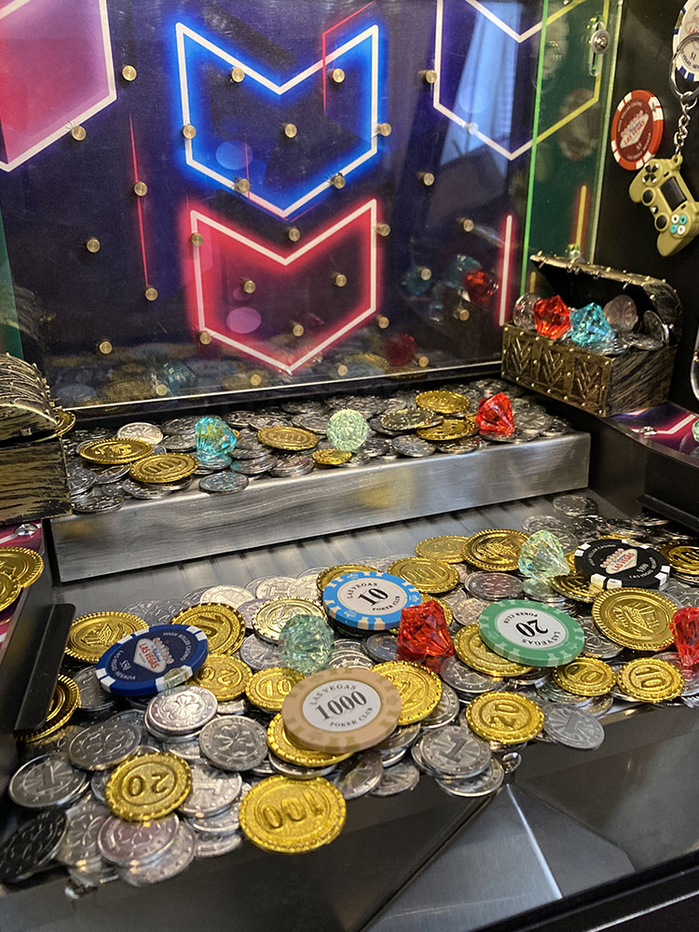
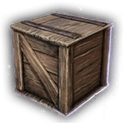
Puzzle Inspiration
The Talos Principle
Coinpusher Inspired part of the puzzle later on
Portal
Sokoban Games
Crates inspired by many games, mainly BG3, also inspired the object highlight

Slide 3
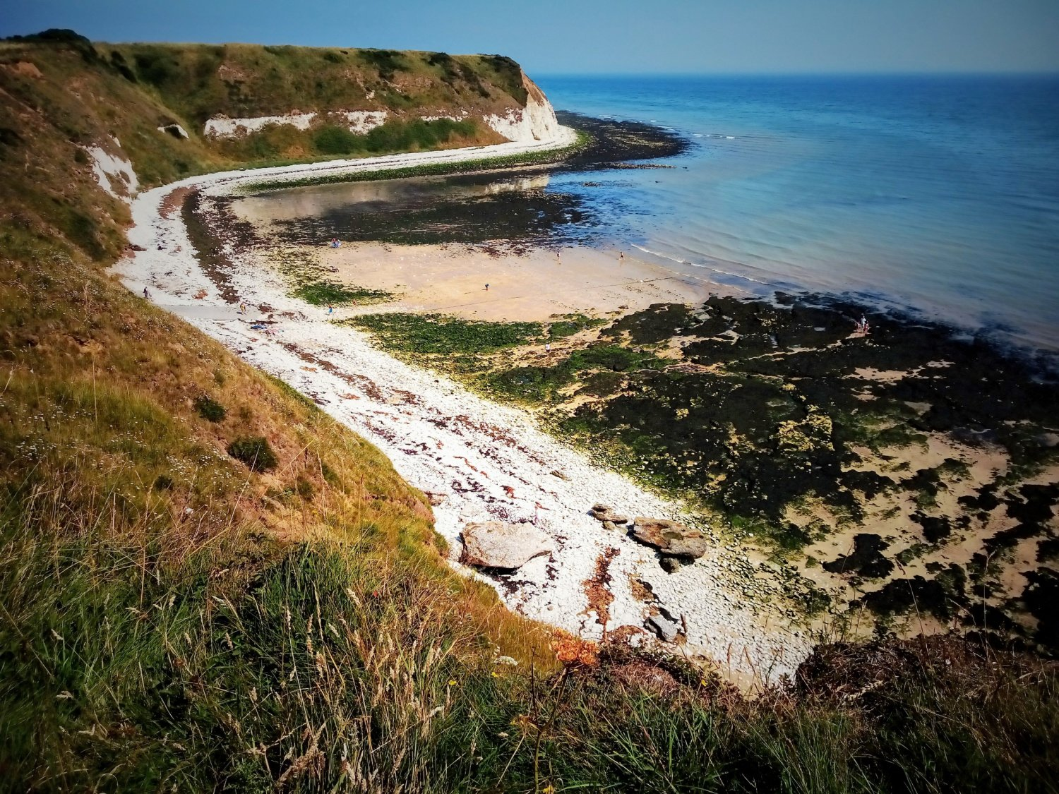

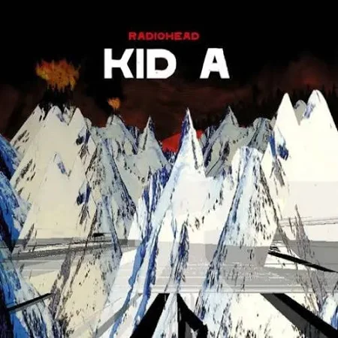
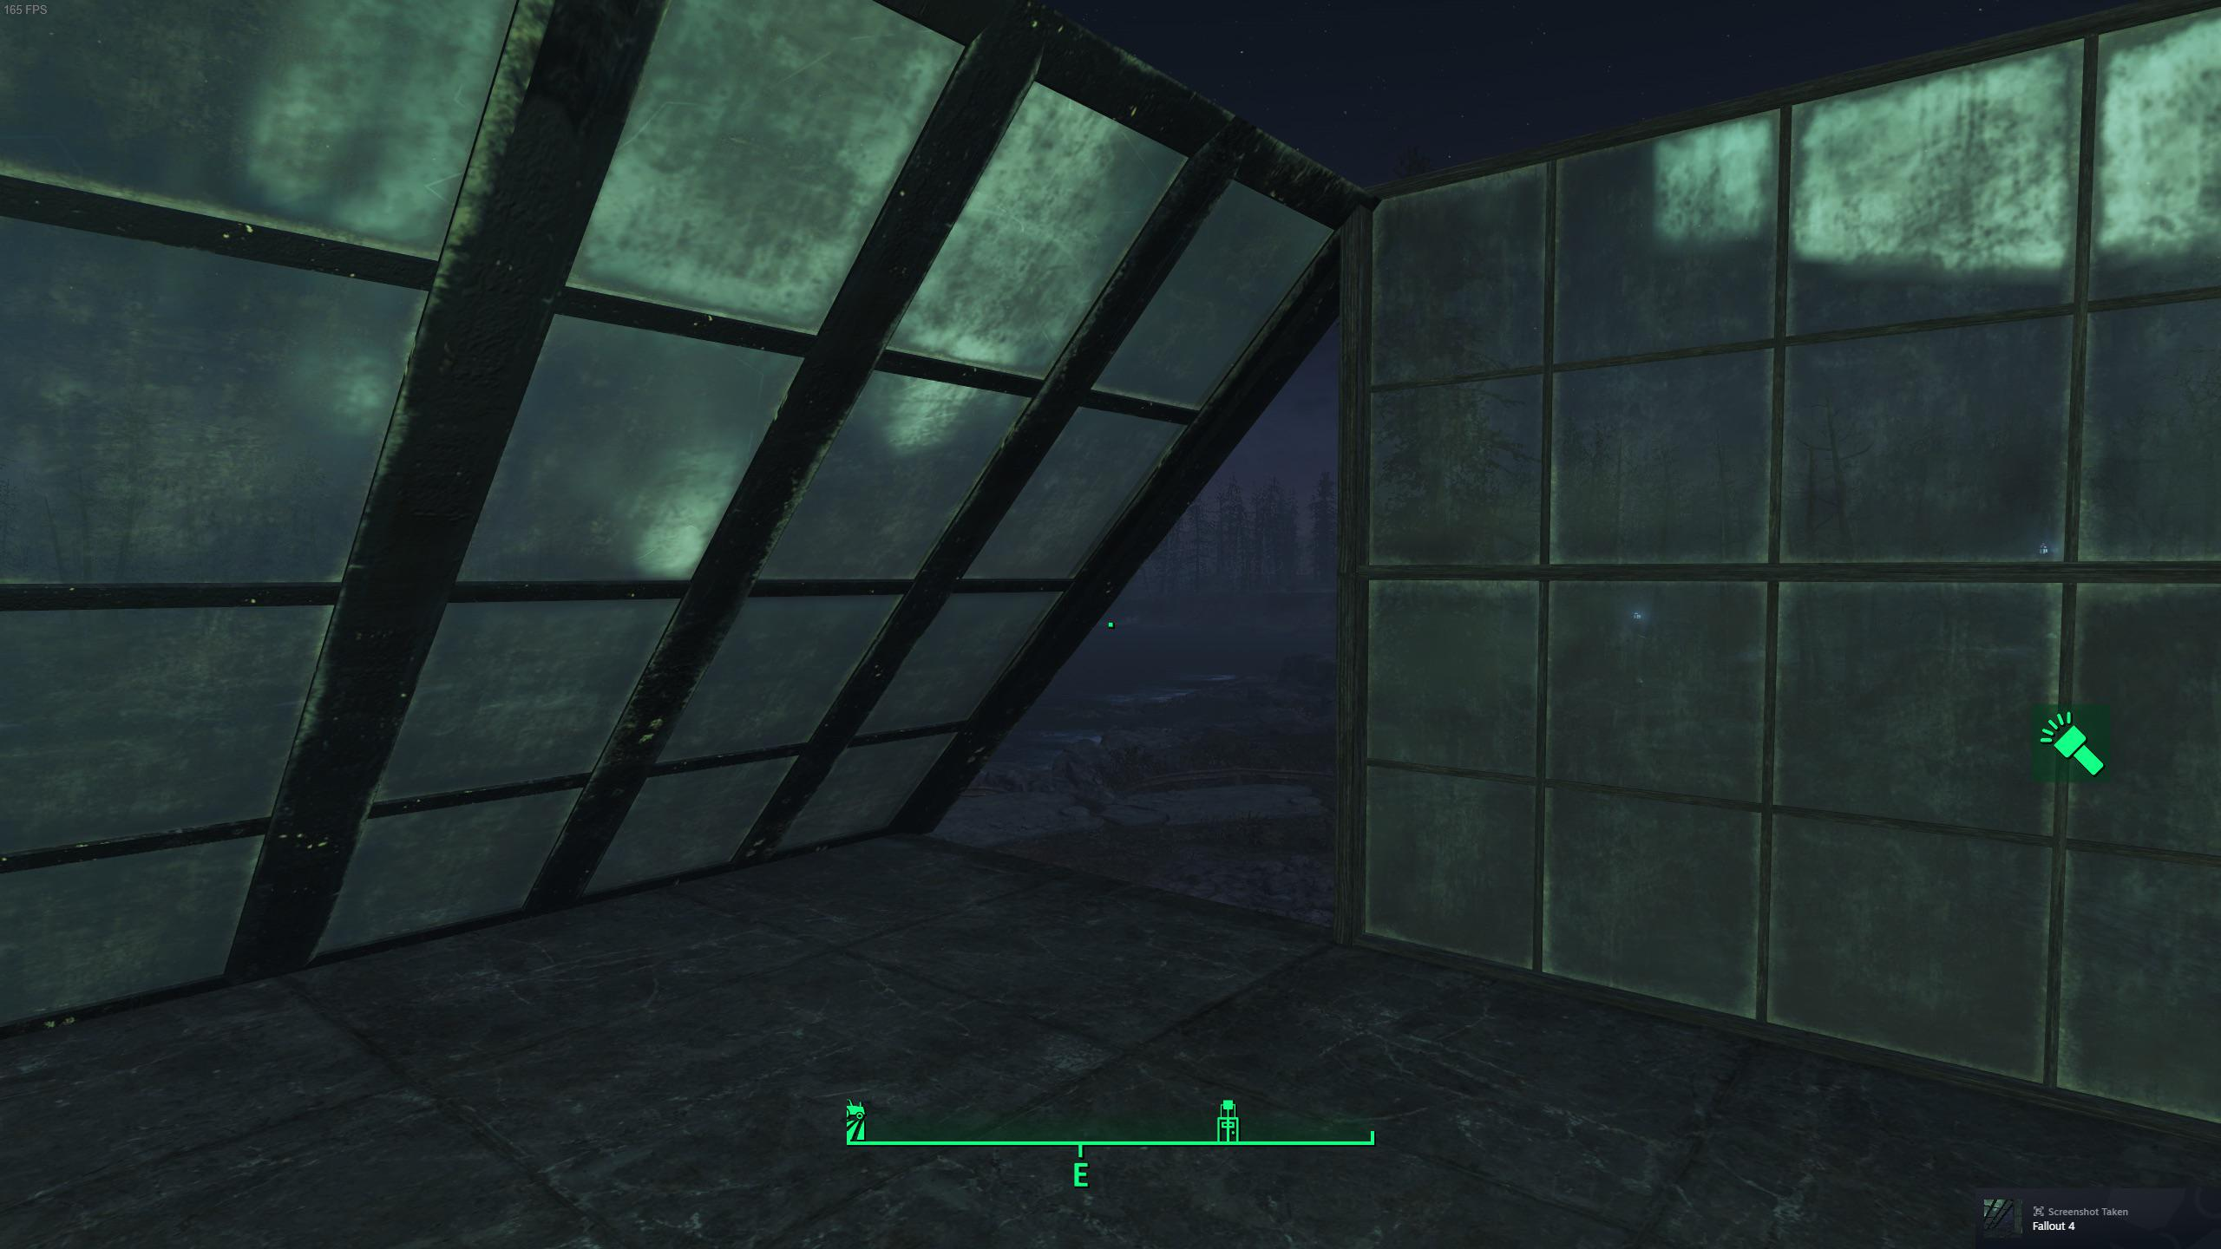
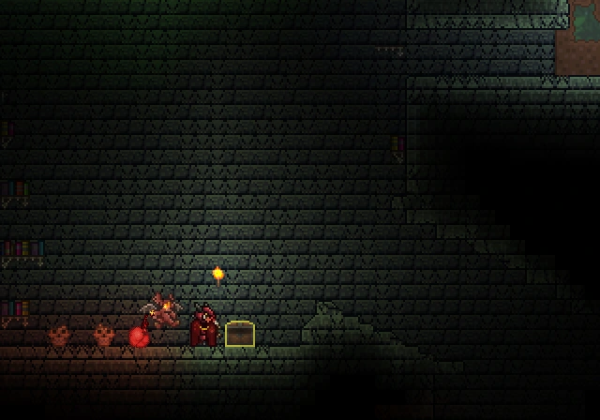
Material Inspiration
The rocky texture was inspired by one of my home towns local beach, Danes Dyke, where it is quite mossy
Shader from Shadertoys inspo, also inspired slightly by radiohead album cover inspired the HLSL material
Fallouts murky atmosphere inspires the green foggy glass
The chipped and damaged brick texture inspo, also inspired the dark and gritty aesthetic

